Slide 1
Calligraphy Masterpieces of China
MIT ESP Spark 2023
By: Vivian and Zi

Slide 2
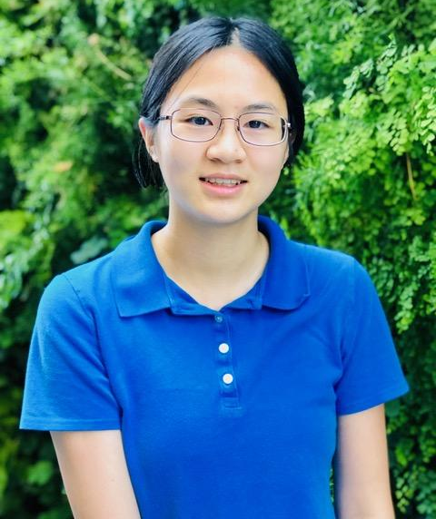
Introductions
Vivian
Zi
MIT Class of 2025
Course 20 (Biological Engineering)
Took Chinese Calligraphy
MIT Class of 2025
Course 5-7 (Chemistry & Biology)
Took Chinese Calligraphy

Slide 3
Discussion
1. What made you sign up for this class? Have you practiced Chinese calligraphy before or learned Chinese before?
2. Do you know much about Chinese artworks or history of Ancient China? If so, what do you know?

Slide 4
Basics of Calligraphy

Slide 5
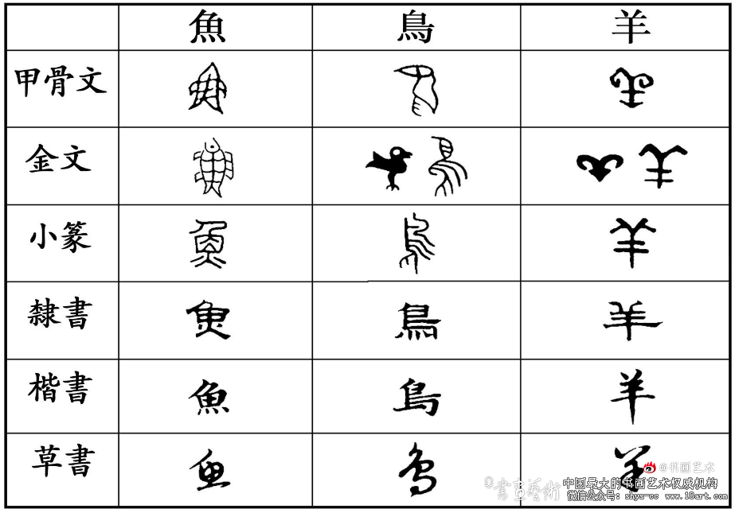
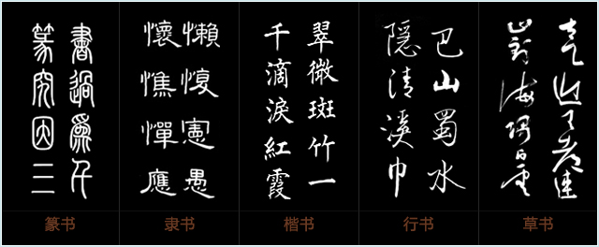
Calligraphy in Chinese Society
Calligraphy was an indication of one’s knowledge and status
All the pieces in this class are xing shu, semi cursive script
Calligraphy still written in traditional, NOT simplified form
Transitioned from pictorial to a form of art

Slide 6
Orchid Pavilion Preface

Slide 7
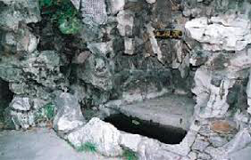
Wang Xizhi （王羲之）
Background: wealthy family
Known for running script, semi cursive script
Rinsing inkstone pool shows his devotion to the art
Origin of some Chinese idioms come from his life!

Slide 8
What changes do you notice from right to left in the calligraphy?

Slide 9
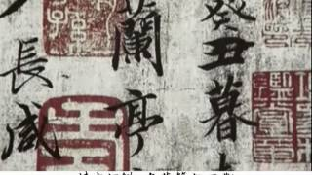
Introduction
Best running script in the history of Chinese calligraphy
Known for its grace, elegance, and power
Ones written by Wang are lost, few copies remain today
Still important in Chinese culture (pop song by Jay Chou)

Slide 10
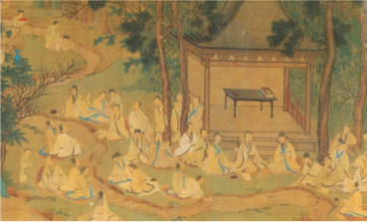
Historical Context and Background
Invited 42 literati for the Spring Purification Festival
They composed poems while socializing
This festive mood made Wang Xizhi happy
At the end, however, poem is about life and death

Slide 11
A Requiem to My Nephew

Slide 12
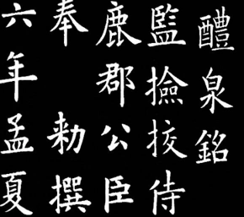
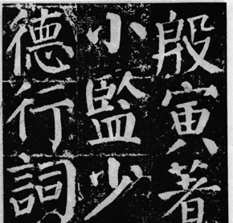
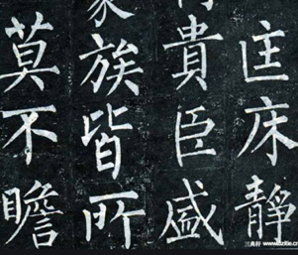
Yan Zhenqing （颜真卿）
Developed Yan style for regular script
Famous for A Requiem to My Nephew
How would describe his calligraphy vs other styles?
Ou （欧）
Yan （颜）
Liu （柳）

Slide 13
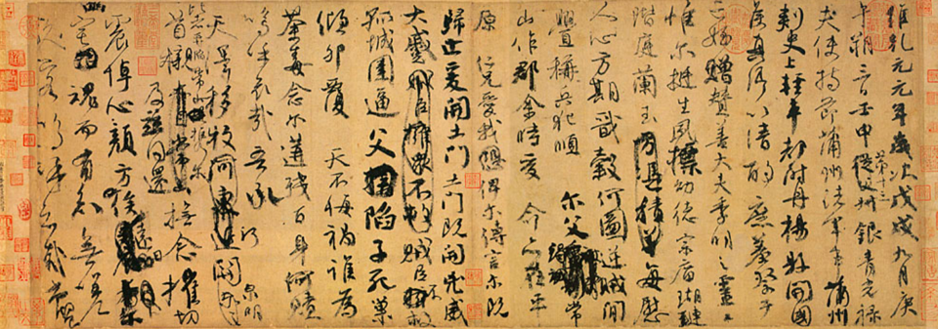

Slide 14
Introduction
Currently in the Taiwan National Museum in Taipei
Rarely on display because of the frail condition
Only been loaned overseas twice:
National Art Gallery in Washington DC in 1997
Tokyo National Museum in 2019
Exhibition in Japan stirred controversy in China

Slide 15
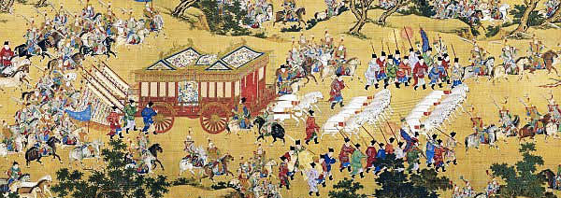
Historical Context and Background
An Lushan rebellion, end of the Tang Dynasty
In the war, his nephew got brutally murdered
The poem expresses his grief of losing his nephew
Are there any interesting strokes that stand out to you? Can you tell how the calligraphy displays his emotions?

Slide 16
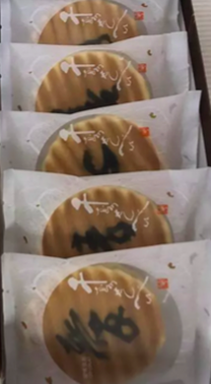
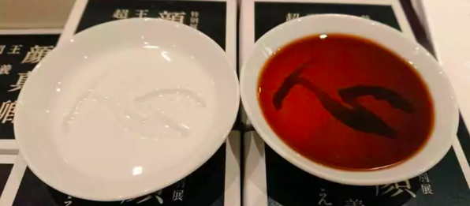
Recent Events
Why was the Tokyo exhibition controversial?
China and Taiwan tensions, China and Japan’s relations
Very fragile, should not go overseas
There were gifts and souvenirs based on Yan Zhenqing’s poem, weren’t aware of its meaning
Context: the poem is very somber, sad

Slide 17
Cold Food Observance

Slide 18
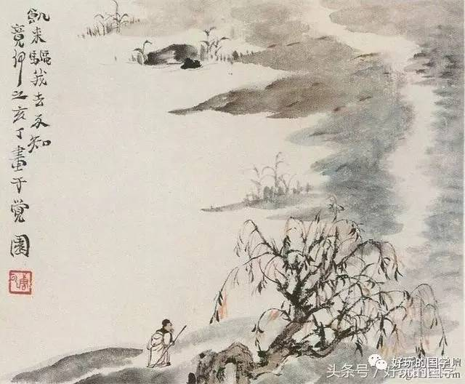
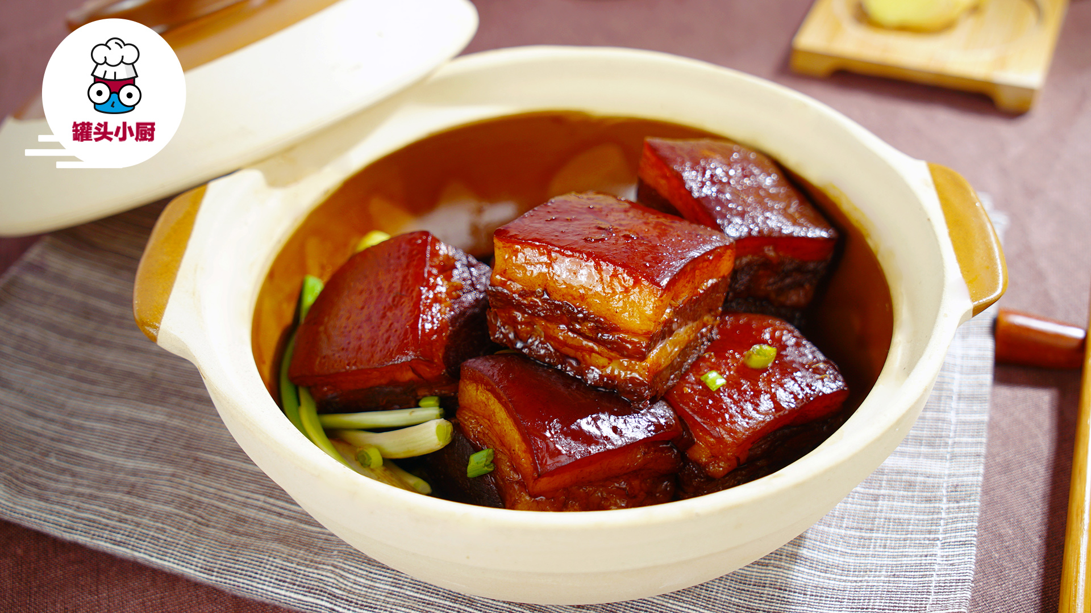
Su Dongpo（苏东坡）
Was involved in literature, politics, arts, medicine…
Made the infamous Dongpo pork recipe (东坡肉)
Known for Cold Food Observance (寒食帖)

Slide 19
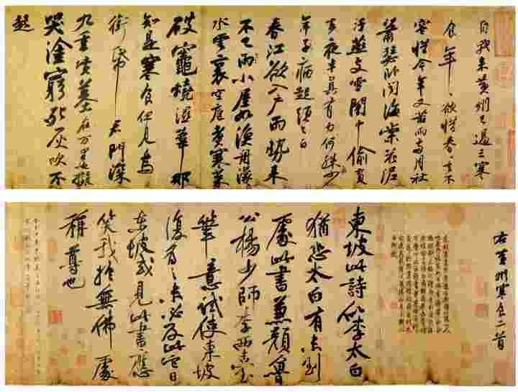

Slide 20
Introduction
Currently in the National Palace Museum in Taipei
Heavily combines poetry with calligraphy
The third best calligraphy piece written in running style
Was brought to Japan before bought by the National Palace Museum

Slide 21
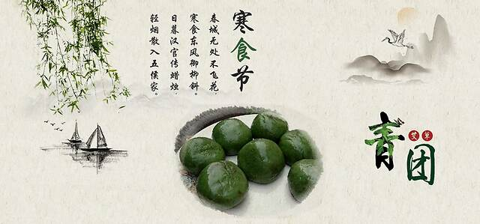
Historical Context and Background
Written during the Northern Song Dynasty (960-1127)
Written when Su was banished to Huangzhou
Expresses his loneliness and emotions during the Cold Food Festival

Slide 22
Modern Calligraphy

Slide 23
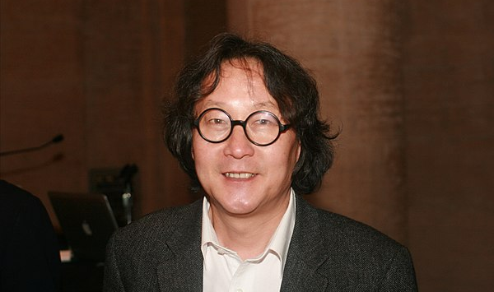
Xu Bing（徐冰）
Served as vice-president of the Central Academy of Fine Arts
Square word calligraphy to express the English alphabet
One of most well known pieces is Tianshu ("Book From the Sky") that uses thousands of invented “words”

Slide 24
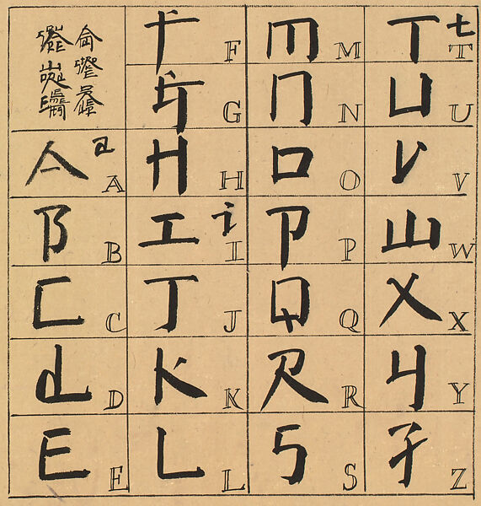
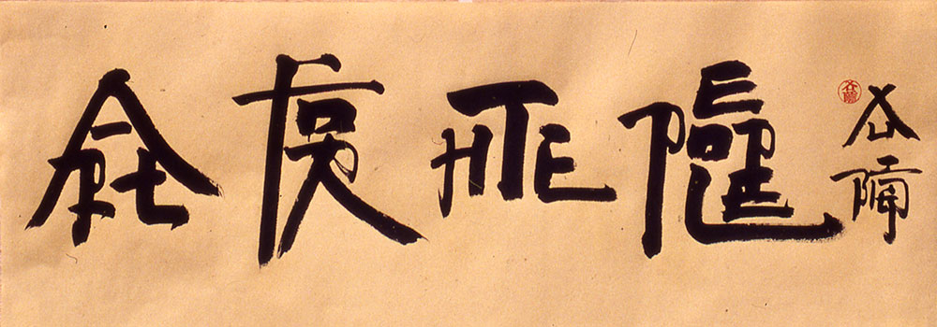

Slide 25
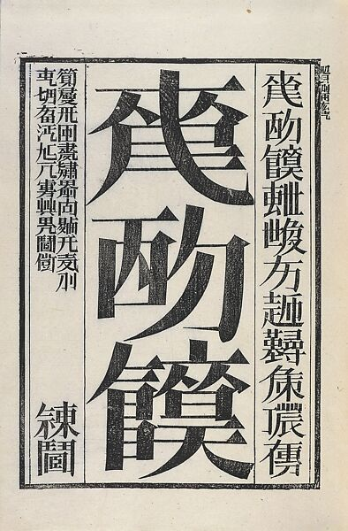
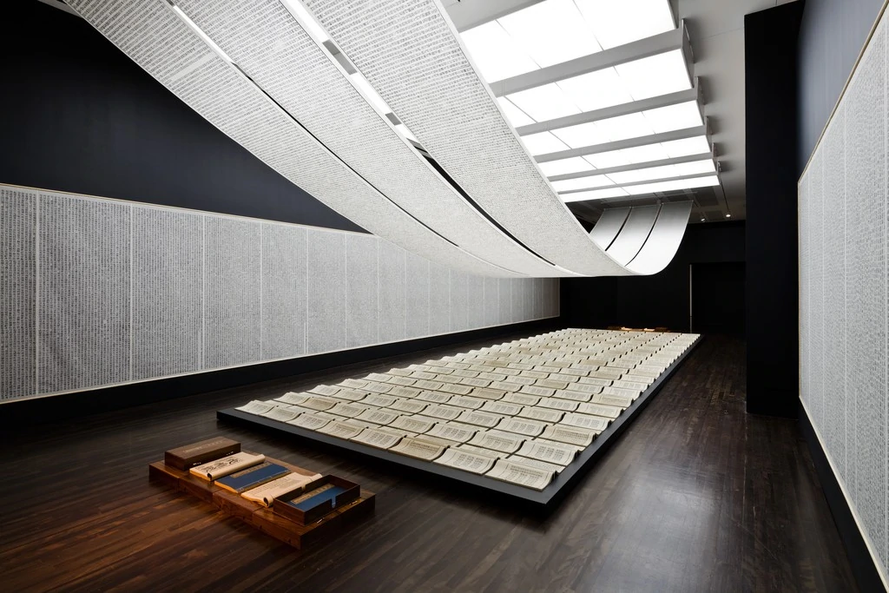

Slide 26
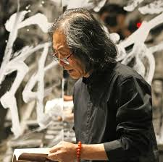
Wang Dongling (王冬龄)
Director of the Modern Calligraphy Study Center at the China National Academy of Arts
Known for luan shu, or mad, cursive script calligraphy

Slide 27
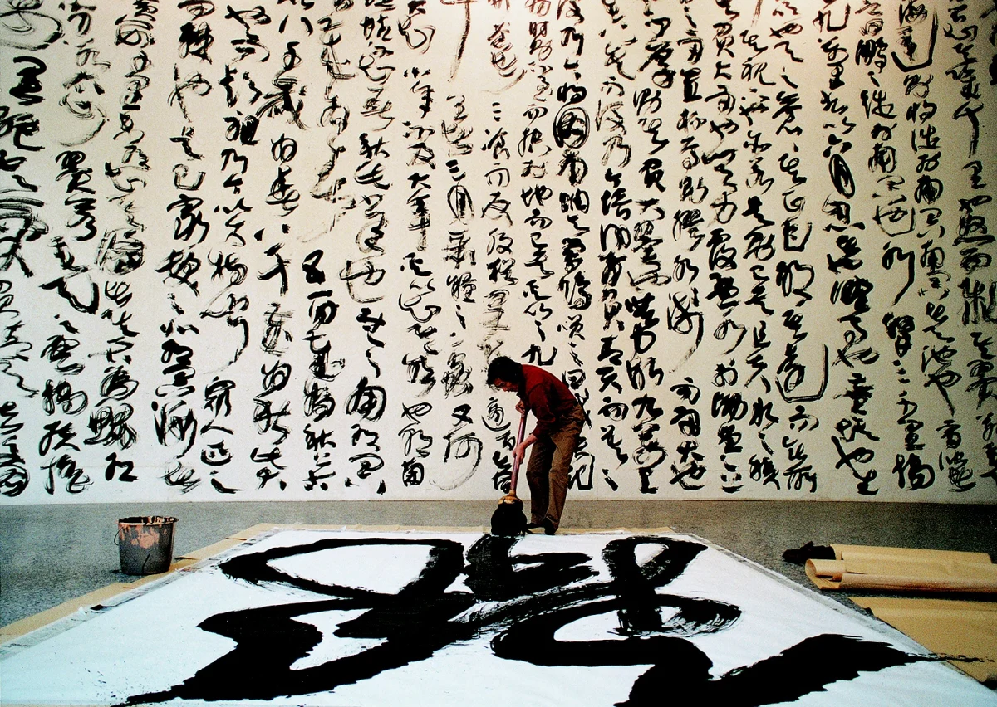
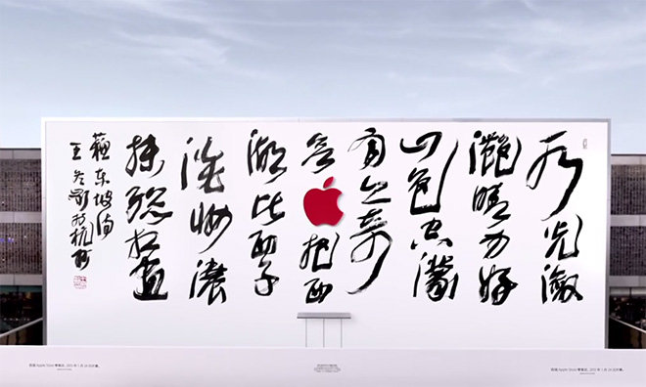
Do you think this is considered Chinese calligraphy?

Slide 28
Activity: Write your name in square calligraphy!

Slide 30
Acknowledgements
Thank you 周老师 for inspiration for the slides! Slides were taken from IAP 2023 21G.111: Chinese Calligraphy

Slide 31
Calligraphy We Wrote in a Month

